Slide 1

Creating Things That Think - Project 1
Eric Martin
September 14, 2021
IDEA 310L

Slide 2
Description of Design Process
Design requirements :
- Using at least two inputs
- Using at least two outputs
Design Process :
- Want to implement joystick as an analog input
- Want to implement LED’s
- Want to implement sound
- Want the design to look nice and compact

Slide 3
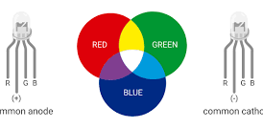
Description of Design
Utilizing the X-Y-Axis potentiometers found in the analog joystick, I have created a simple device that allows the user to manually change the color of an RGB LED depending on the position of the joystick.

Slide 4
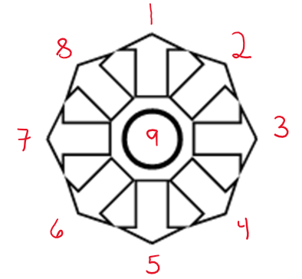
Description of Design
The joystick also has a push button input switch.
I have made it so that when the joystick is depressed, depending on the position when depressed, a unique output will occur.
1 – 8 will play a unique song
9 will display a random LED color

Slide 5
Description of Design
Songs:
Final Fantasy Victory Fanfare
Game of Thrones Theme
Hedwig’s Theme – Harry Potter
Imperial March – Star Wars
Mario Theme Song
Jigglypuff’s Song – Pokemon
Keyboard Cat Meme Song – Youtube
Greensleeves – Skyrim
Lights:
9.Random LED color

Slide 6

Schematic

Slide 7
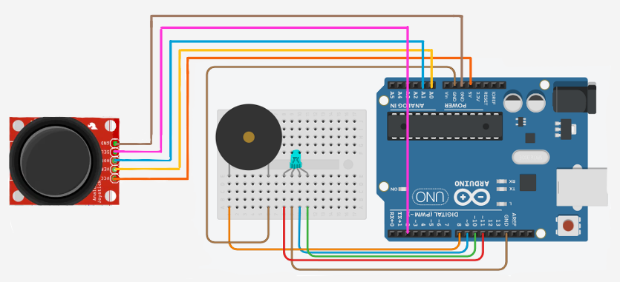
Schematic

Slide 8
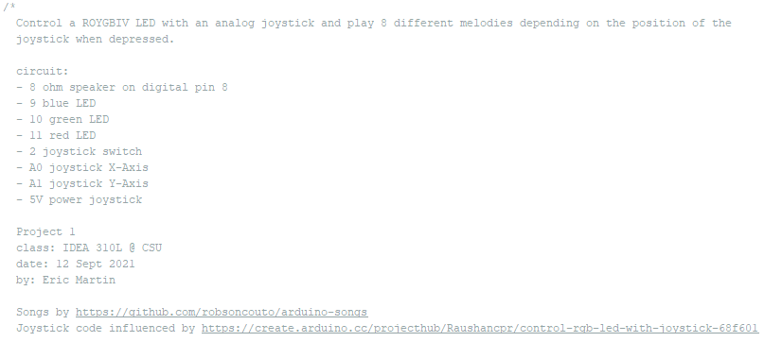
Schematic

Slide 9
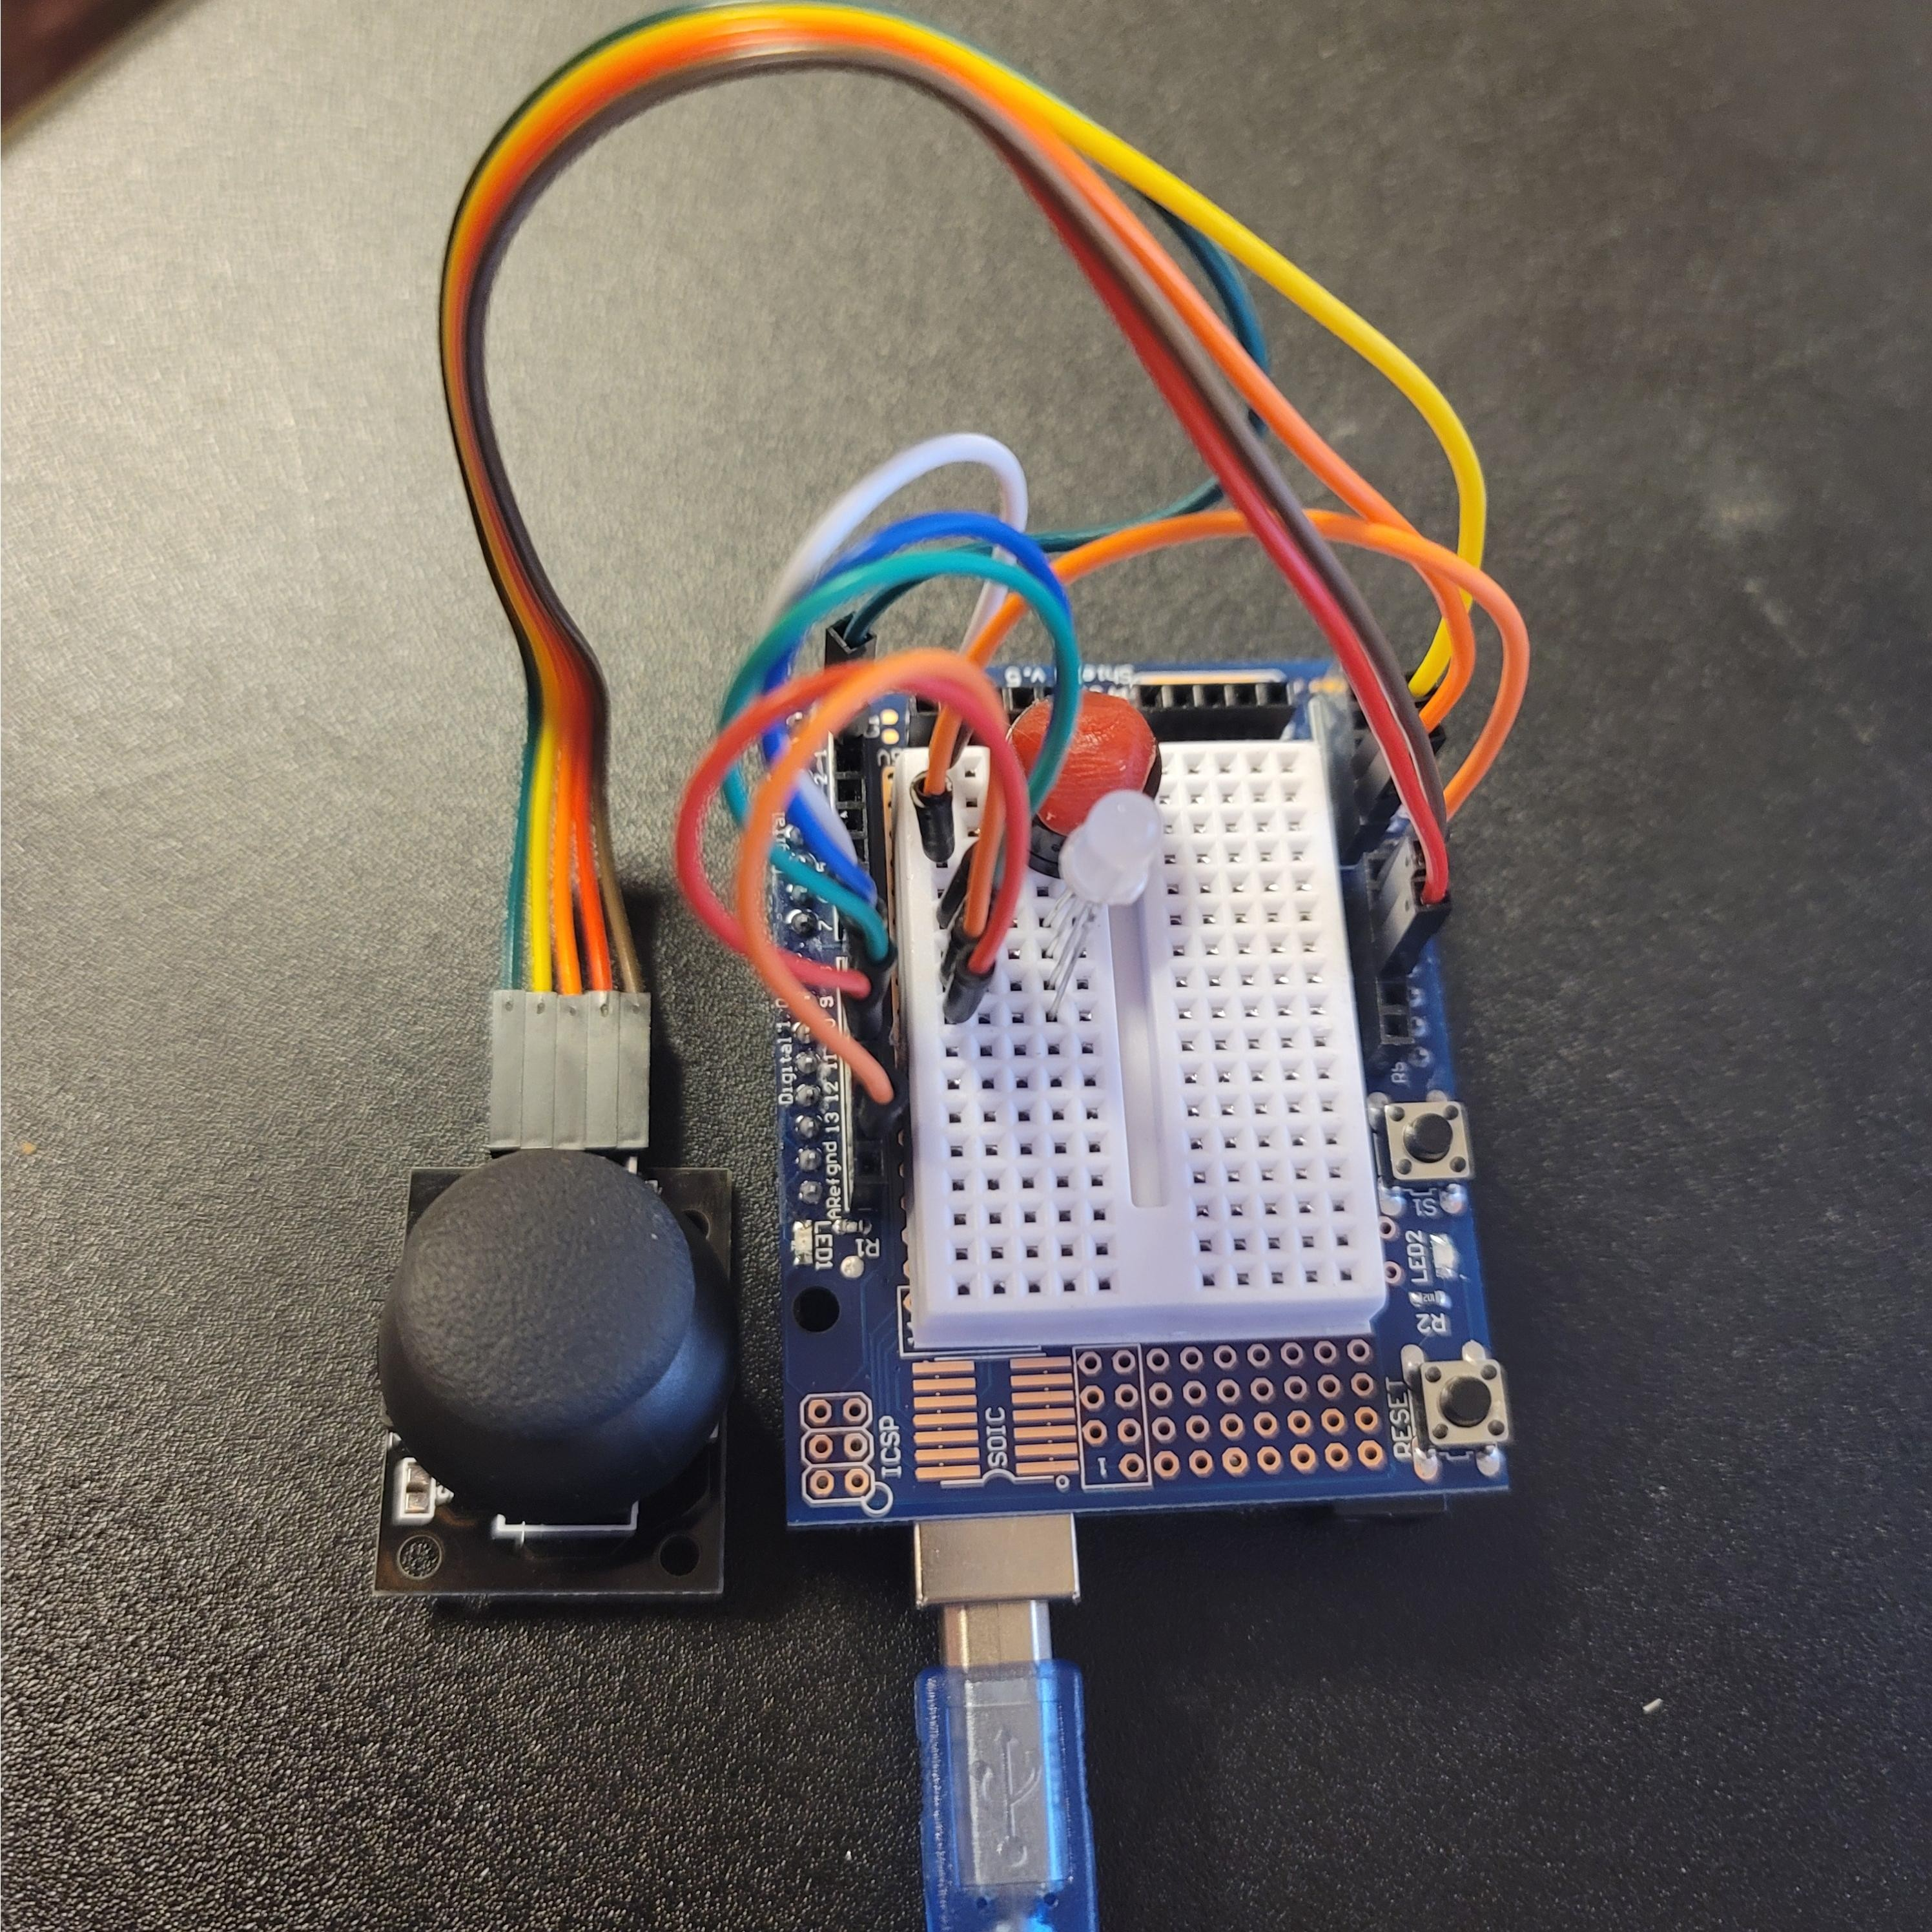
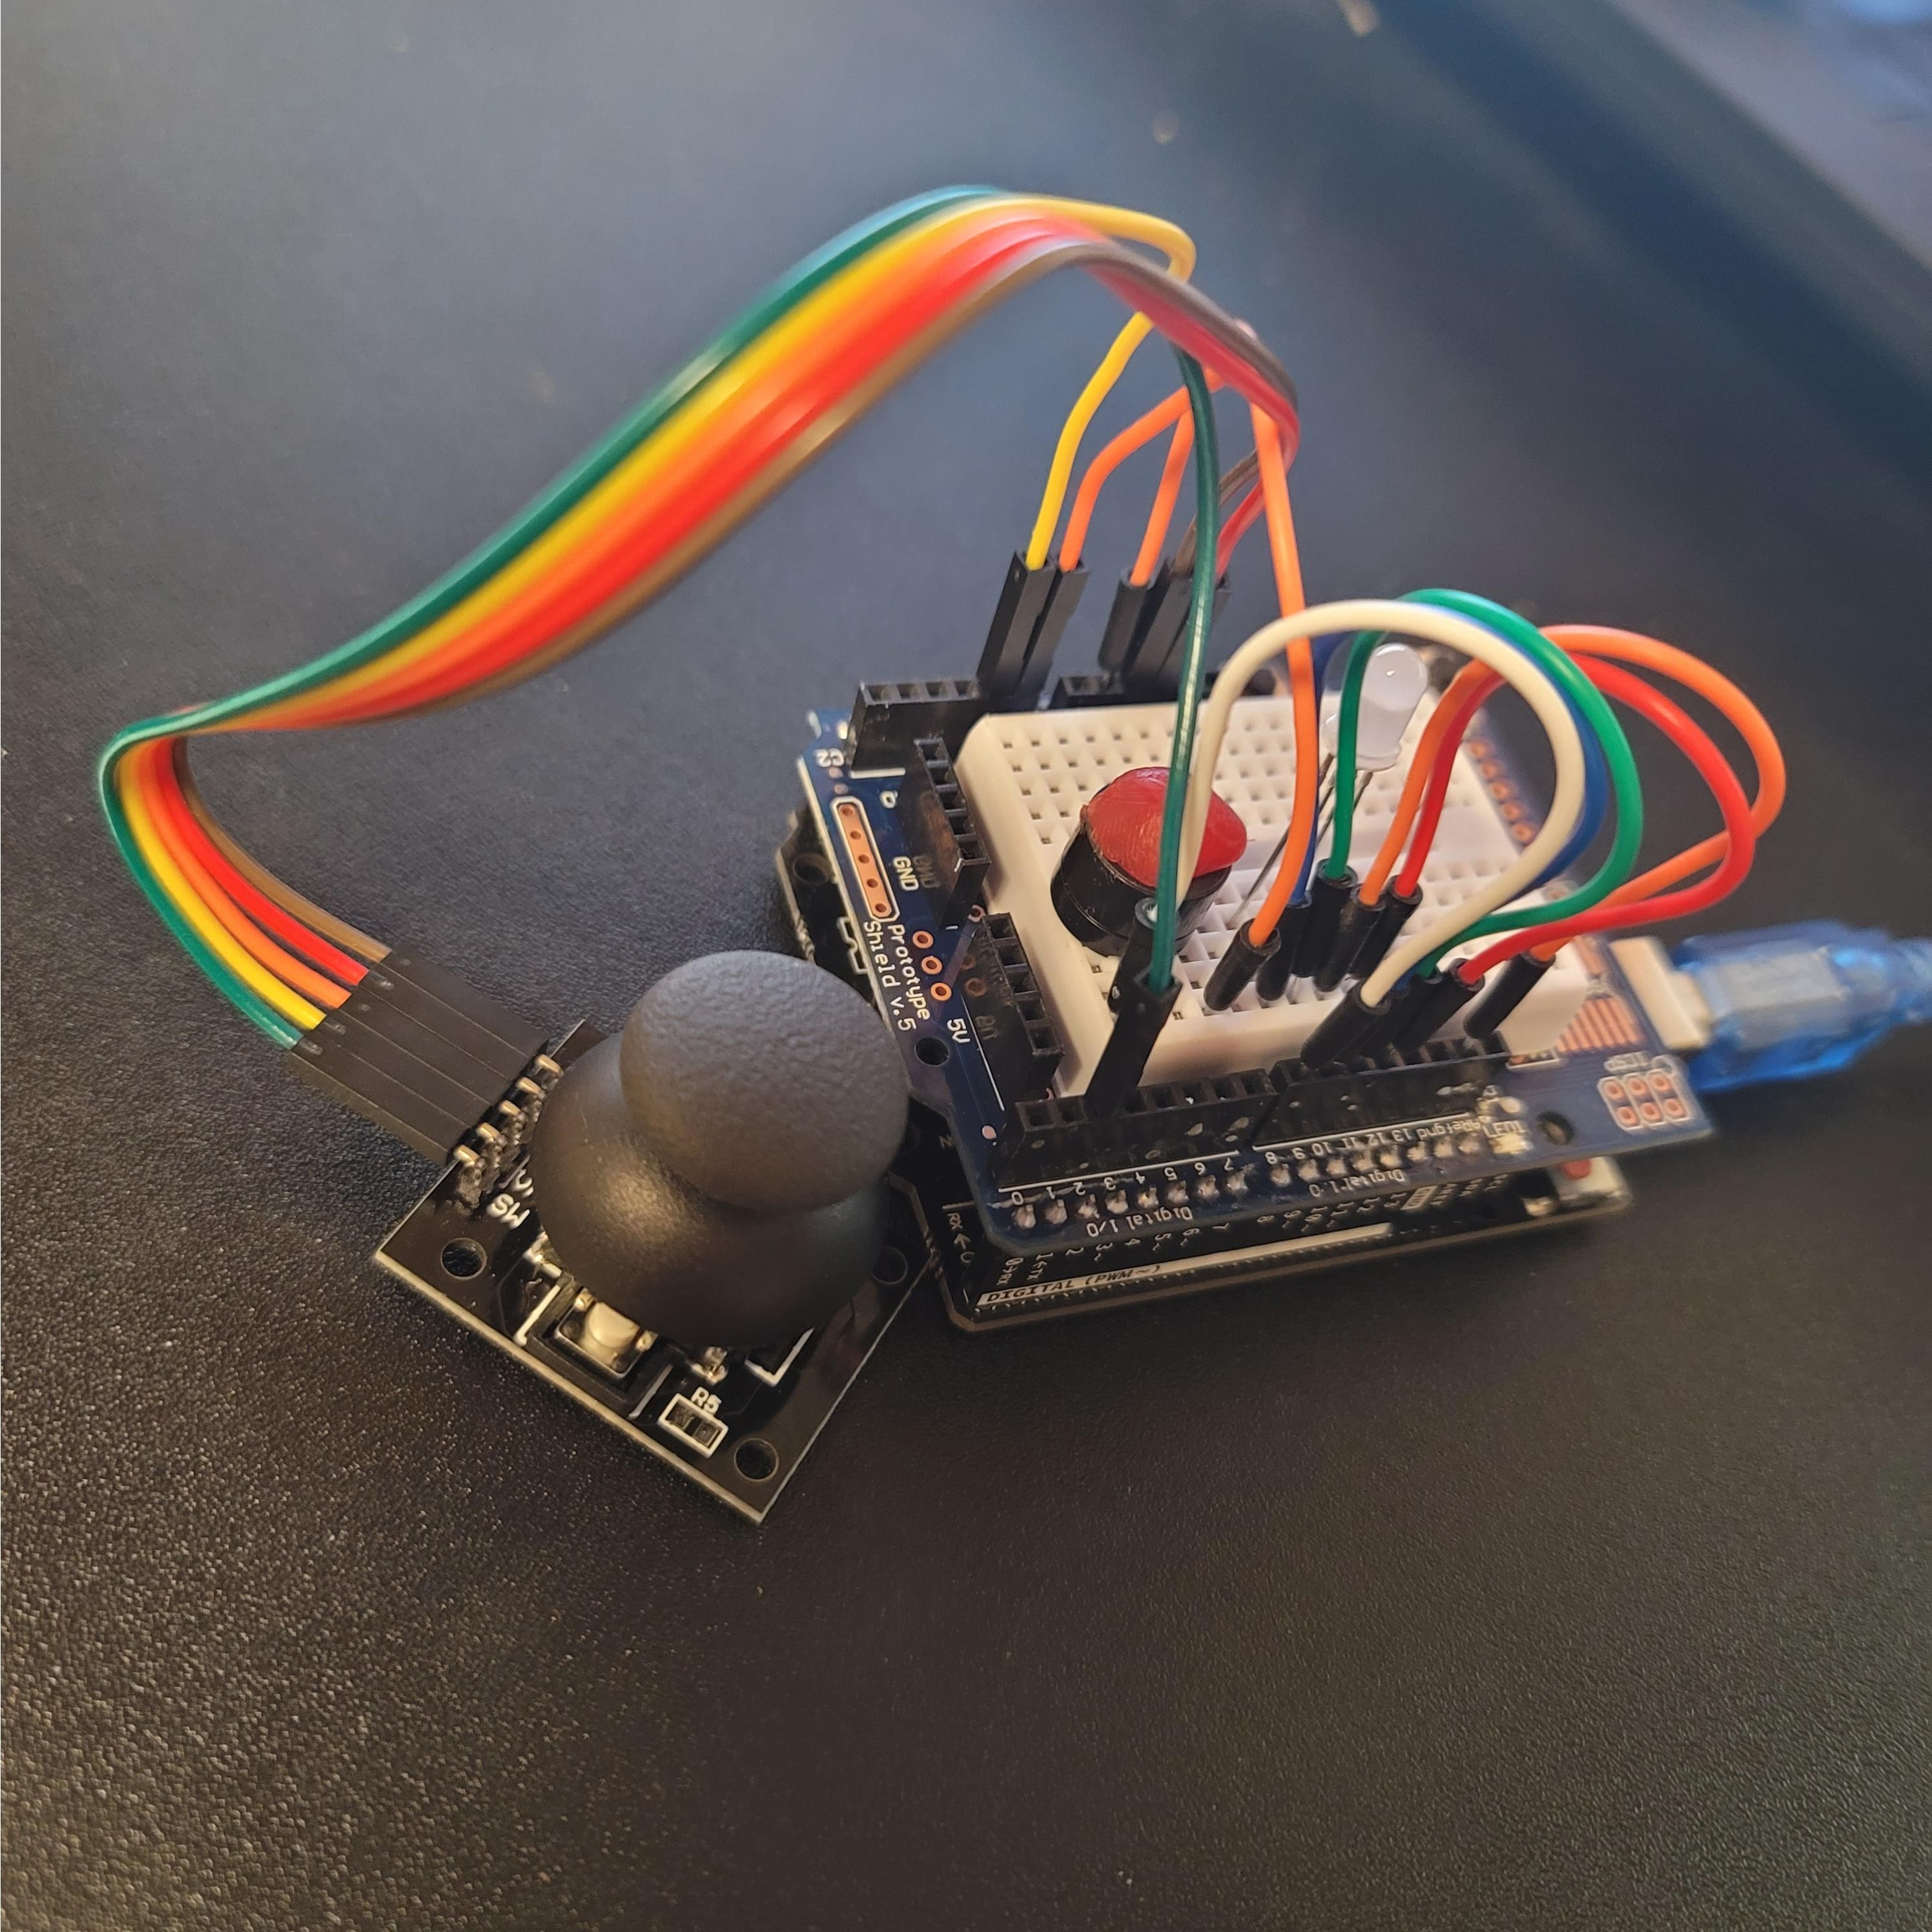
Images of Device

Slide 10
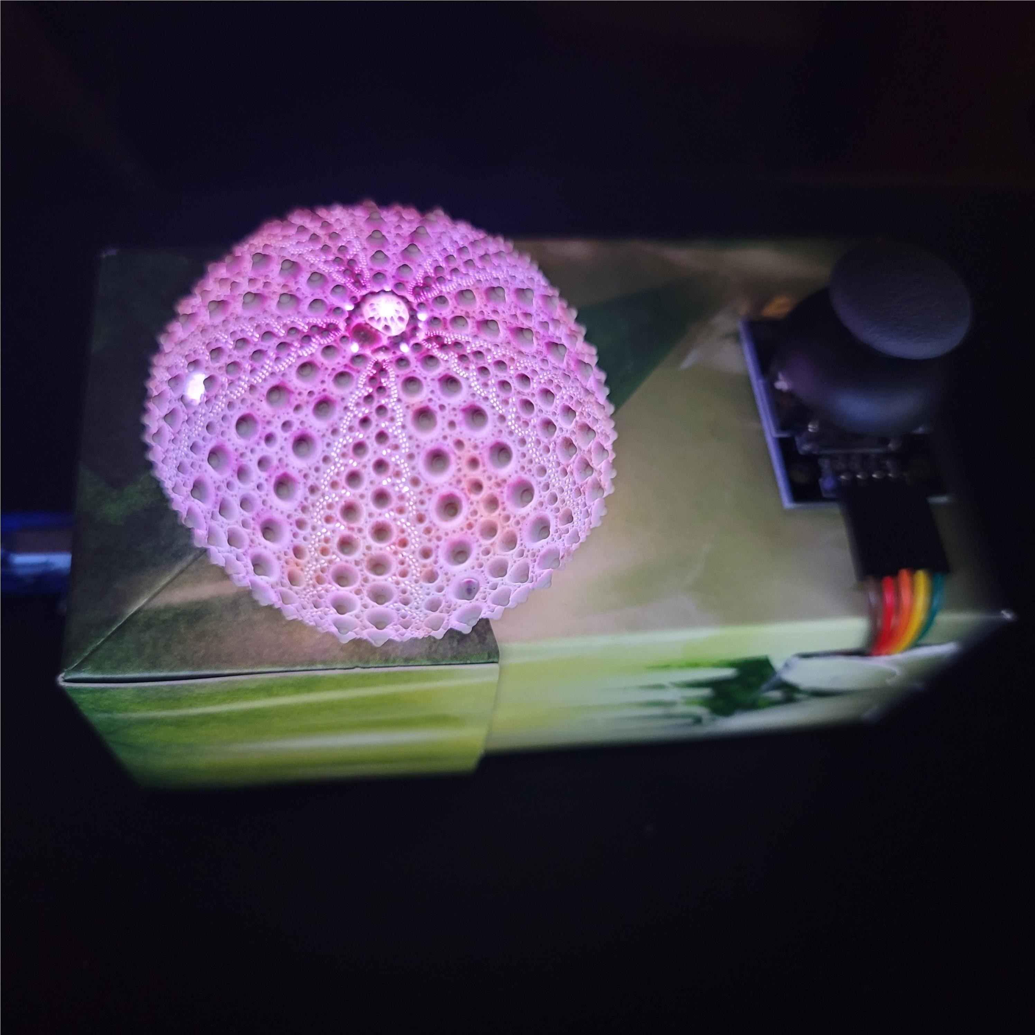
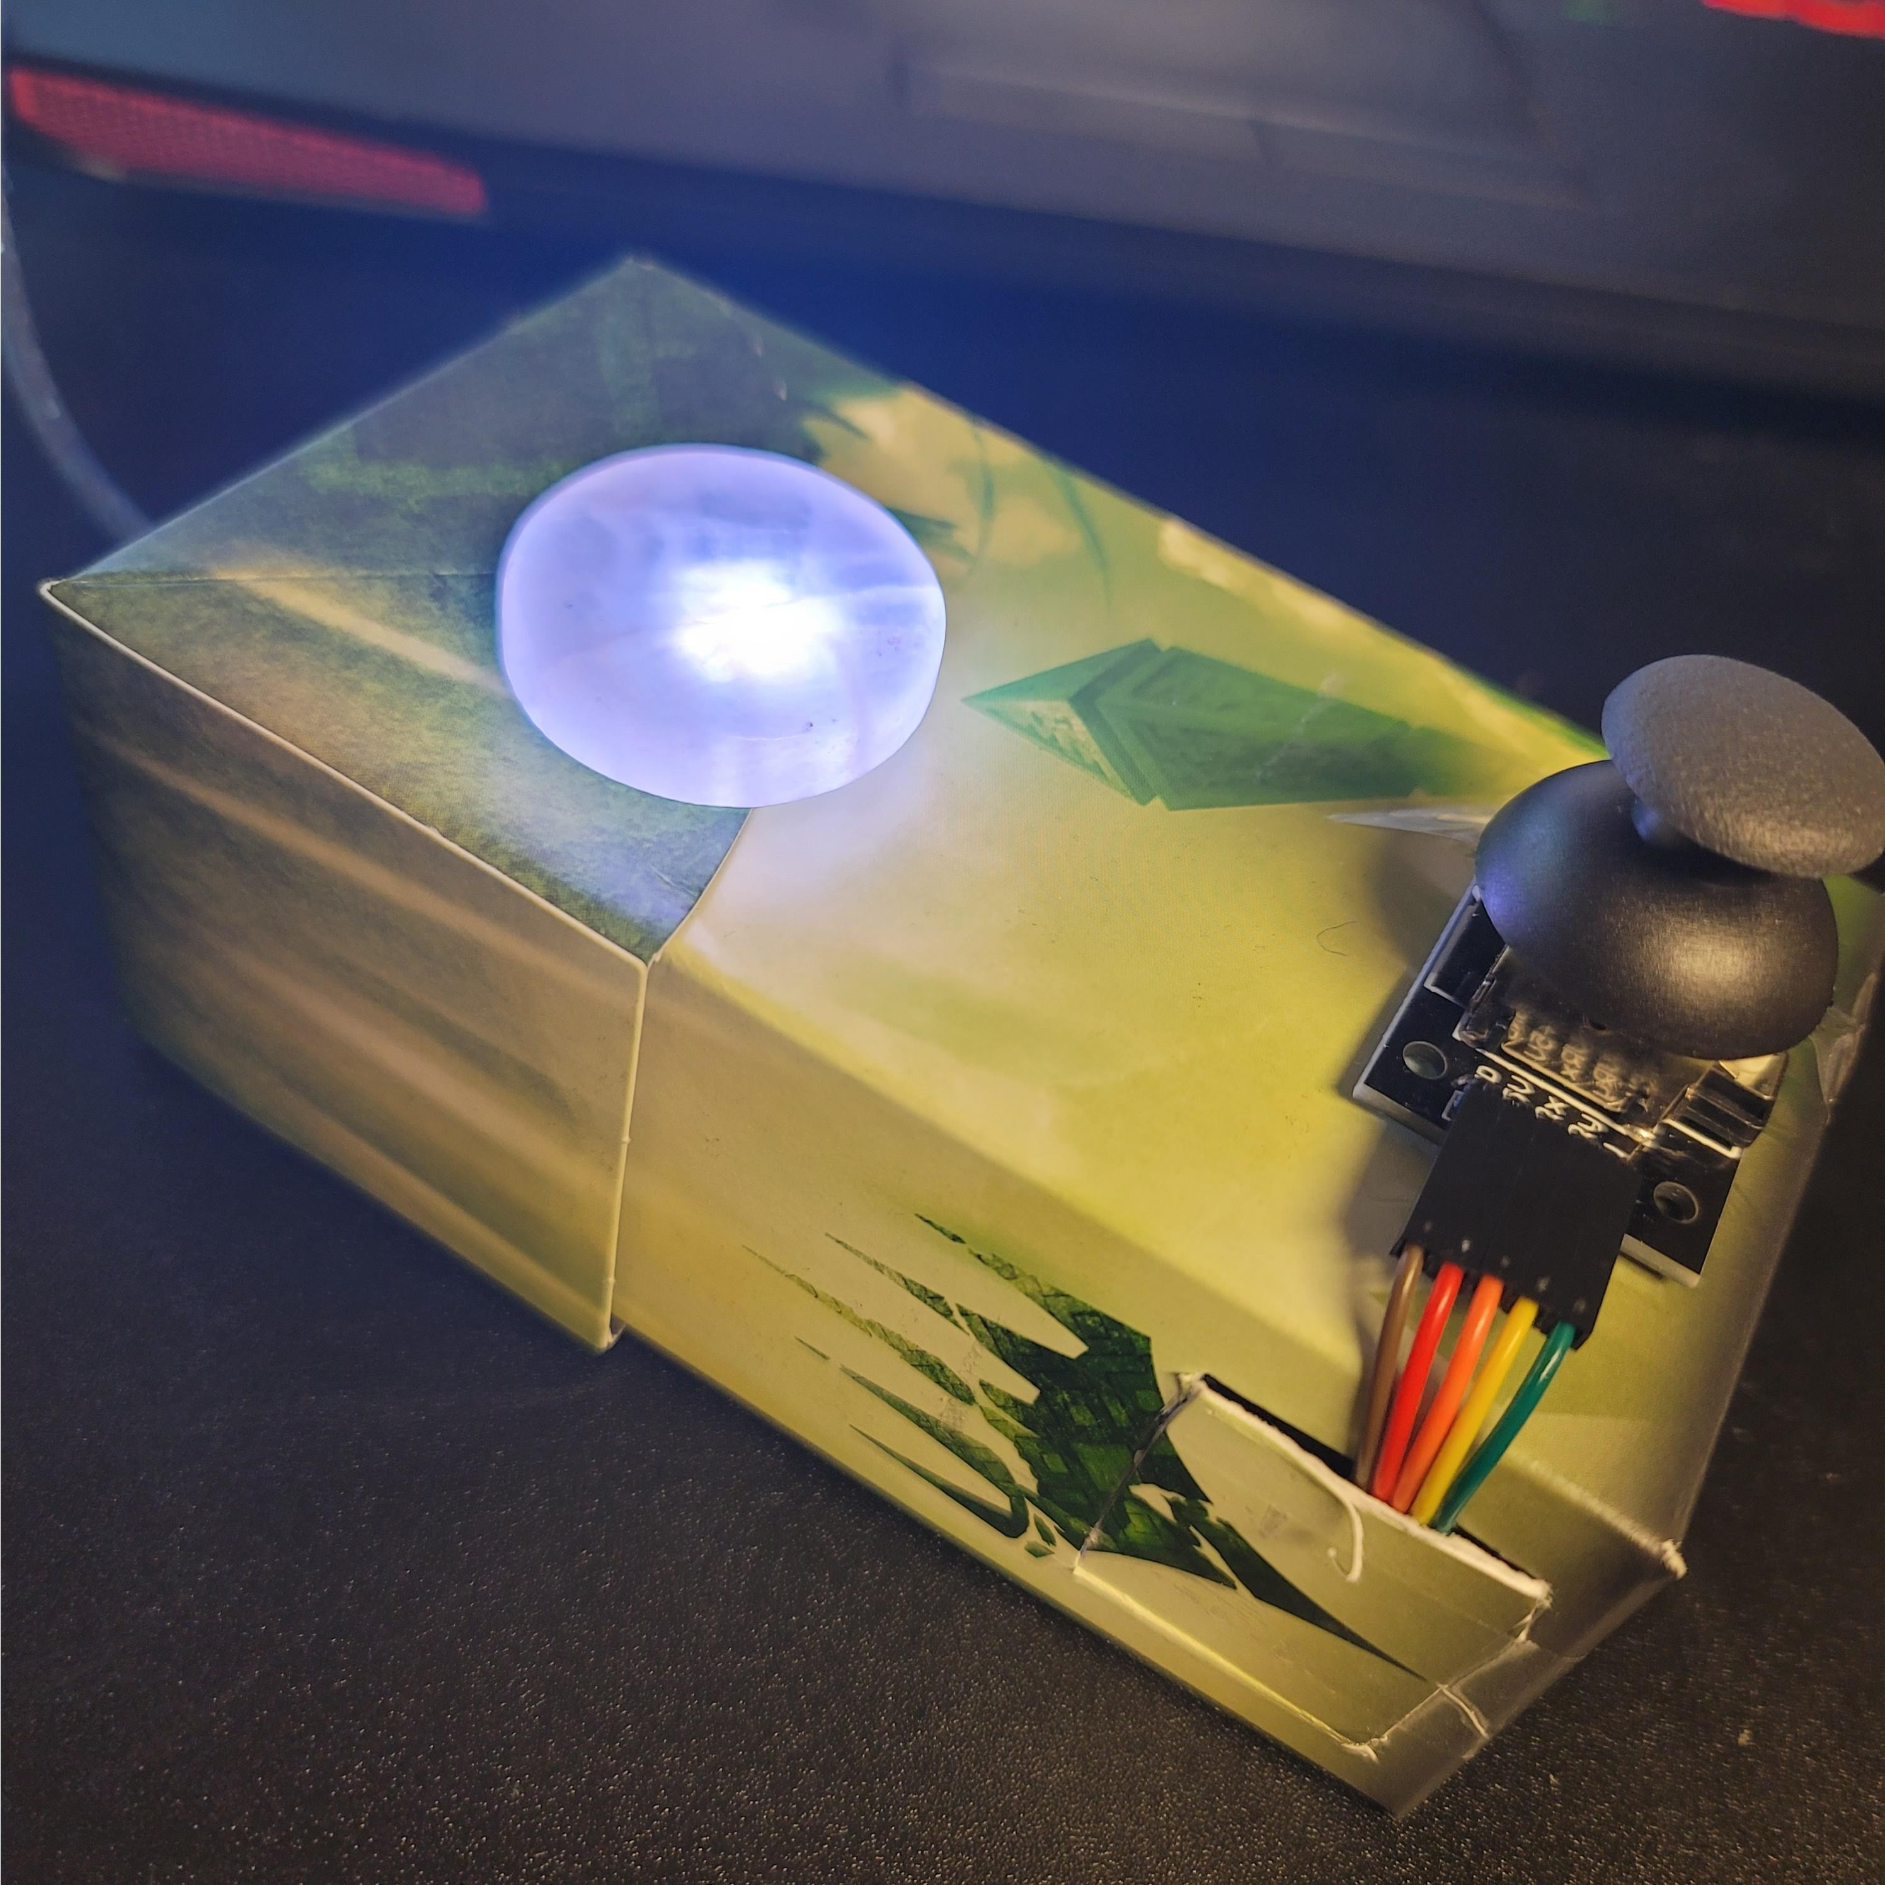
Images of Device – In Box

Slide 11

Code

Slide 12
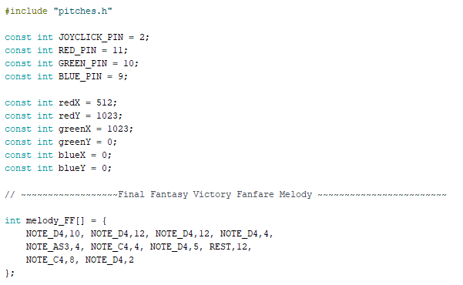
Code

Slide 13
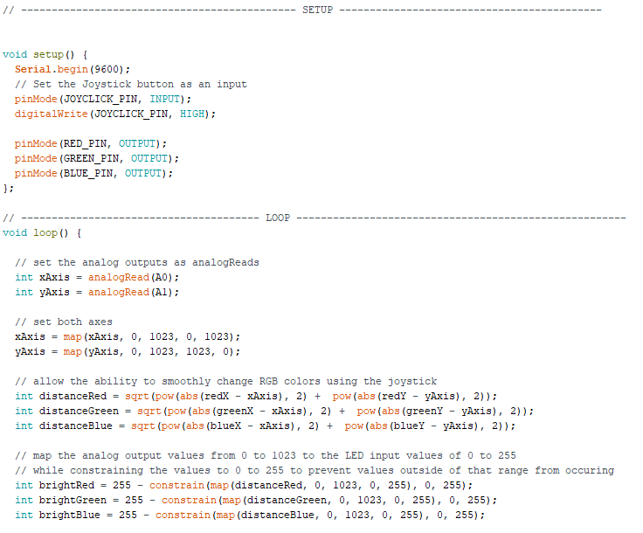
Code

Slide 14
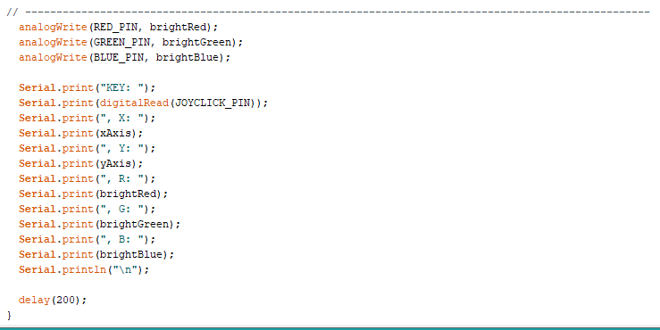
Code

Slide 15
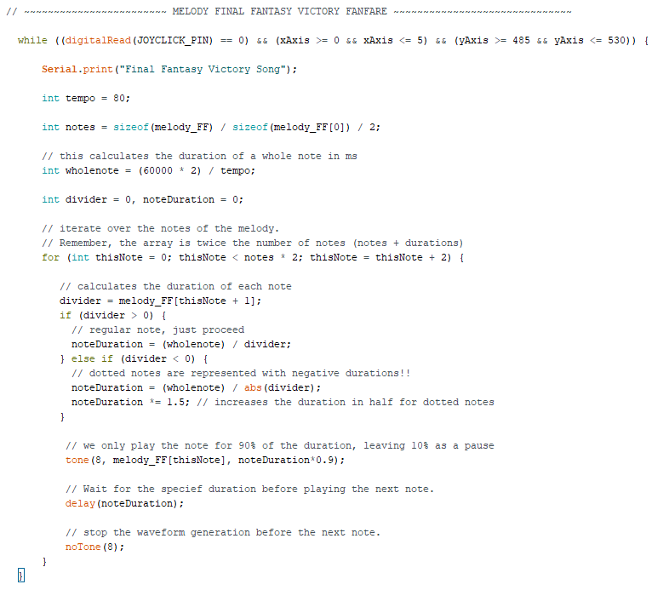
Code

Slide 16

Issues
When activating some songs, the LED turns off.
Unsure about why this is occurring as each melody has the same outline of code.
Program global variables use 79% of the dynamic memory on the heap which leaves less memory and could lead to stability issues.
This is caused by the large amount of melody variables declared
Light transitions when using the joystick are sometimes jumpy rather than smooth.
This may be due to the limitations of the joystick input or the translation from analog to digital input.
Box is flimsily and makes using the joystick harder than it needs to be

